Slide 1
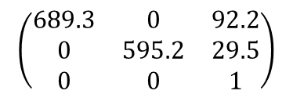
Geo. Cal. result
$$\left(\begin{matrix}689.3 & 0 & 92.2 \\ 0 & 595.2 & 29.5 \\ 0 & 0 & 1\end{matrix}\right)$$
intrinsic:
Radial distortion parameters:
[k1, k2, p1, p2, k3] = $\left[−2.88, −686.59, 0.11, 0.05, 14542.81\right]$

